Slide 1
Evaluating Home Renovation Opportunities in King County, WA
Analysis by Brian Bentson

Slide 2
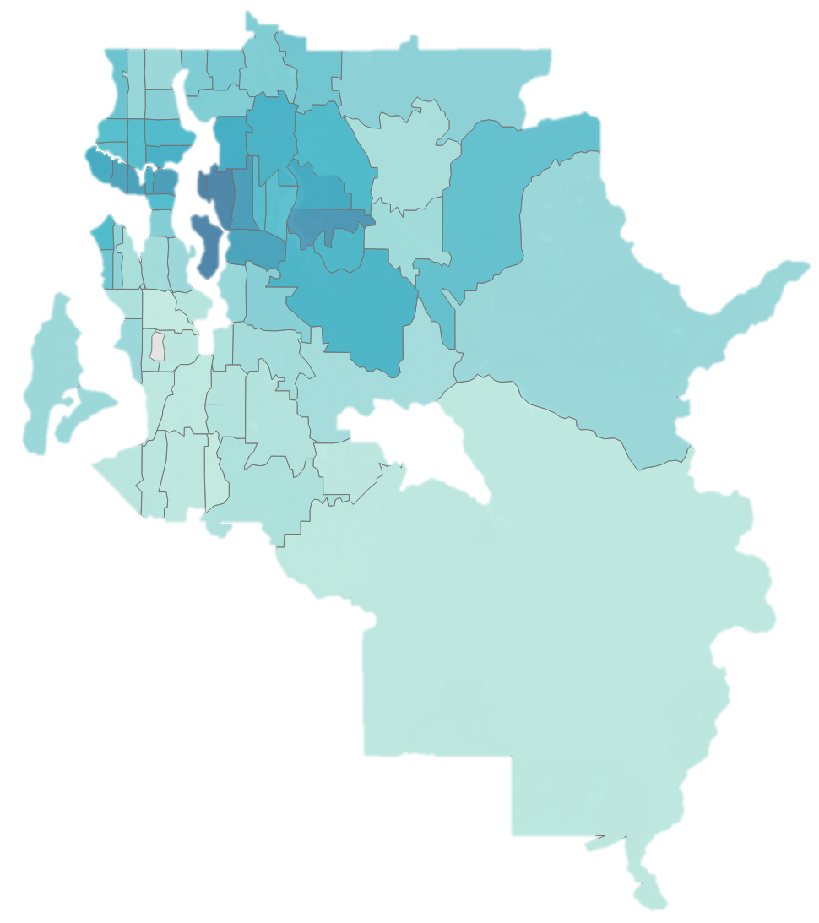
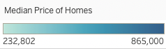
Analysis Overview
Emphasized features of a home which can be renovated that improve home value
~15,000 home sales analyzed from 2014 and 2015
Small and Midsize homes with less than 6 bedrooms
Linear Regression Modeling to understand how housing features affect price
Seattle

Slide 3
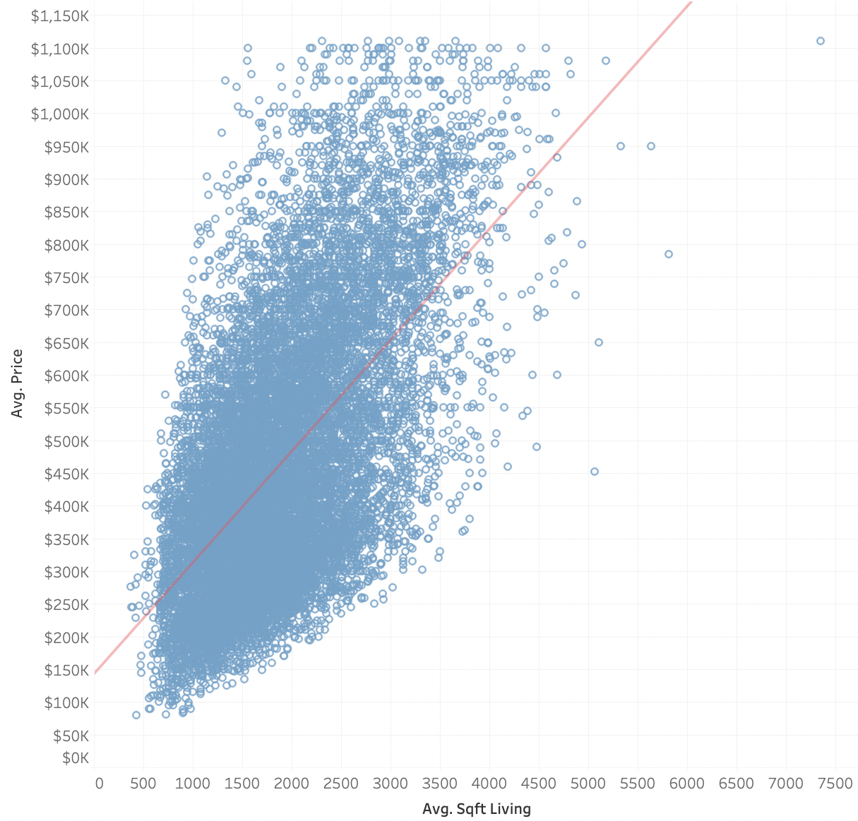
Best Fit Modeling of Home Price
Selected optimal variables that correlate with Price
Focused analysis on center of the data
Model can explain 83% of the variation in price

Slide 4

Biggest Drivers of Home Price
Total Square Feet
Grade
View
Home Age
Condition
Bathrooms
Waterfront
Lot Square Feet
POSITIVE
Renovated
Floors
NEGATIVE
Bedrooms
Basement

Slide 5
Finish a Basement with At Least 350 sqft
Median basement size is 700 sqft

Slide 6
Recommendations
Add a full bathroom (~60 sqft)
$22,000 to the value of a home
If you have an unfinished basement with over 350 sqft of space, finish the basement
Average basement size is 700 sqft in the area, finishing a 700 sqft basement yields $60,000
Use high grade construction materials
Every higher level of materials yields $49,280/level
DO’s
DON’Ts
Item | Potential Value
Add a Bathroom | $22,000/bathroom
Add Square Feet | $120/sqft
Improve the “View” | $35,380/level
Use High Grade Construction | $49,280/level
Item | Potential Value
Add a Bedroom | -$45,981
Add a Floor | -$7337
Finish a Basement with < 200 sqft | -$23,590
Notes:
The estimates for full bathroom square feet from an online search for ”average full bathroom size”.

Slide 7
Conclusion
First bullet point here
Second bullet point here
Third bullet point here

Slide 8
Title and Content Layout with SmartArt
Step 1 Title
Task description
Task description
Step 2 Title
Task description
Step 3 Title
Task description
Task description
Task description

Slide 9
Add a Slide Title - 1

Slide 10
Add a Slide Title - 2

Slide 11
Add a Slide Title - 3

Slide 12
split homes based on sqft_living/sqft_lot to get a townhomes vs single family homes

Slide 13
Add a Slide Title - 4

Slide 14
Add a Slide Title - 5

